Slide 1
The Dweller Left Adrift
No main menu image yet ☹
Made by: James K. Philip D. Vinh M.

Slide 2
About the project
Metroidvania style.
Includes a lot of mechanics (gravity, jump, dash, attack etc.)
Pixel Art style.
3 Levels
First Level Tutorial.

Slide 3
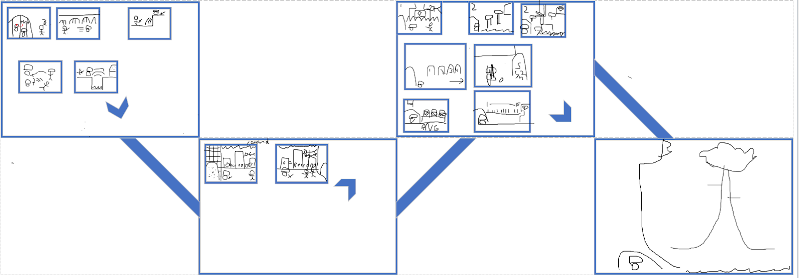
Map Layout

Slide 4
Roles and Achievements
James K. -GDD, World Designer, Text Dialogue, Programmer,
Philip D. -GDD, Level Designer, Some Pixel Art, Menus, Programmer,
Vinh M. -Head Programmer, Develop many mechanics,

Slide 5
Demonstration
In class

Slide 6
Interesting codes
Jumping on and off a platform.
Platform collisions
Scrolling world.
Text Dialogue.
Menus mechanic.

Slide 7
What is next?
Add the characters/level/Menu Pixel Art design.
Introduce Attacks.
Introduce Enemies AI
Might only do 1-2 Levels.
Add sounds.

Slide 8
Problems and issues?
Missing time. (Personnal work, etc.)
Platform collisions

